Slide 3
Turkey on the world map

Slide 4
Different cultures – Different lifestyles

Slide 6
There are seven regions in Turkey

Slide 8
Bursa is one of the biggest cities in Turkey

Slide 9
Bursa at night

Slide 10
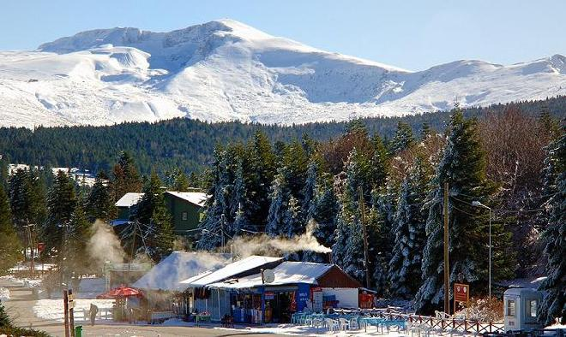
Bursa - Uludağ

Slide 11
We live in Mudanya

Slide 12
Mudanya is a seaside town

Slide 14
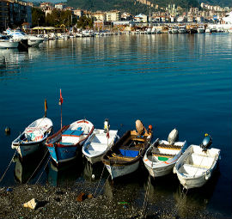
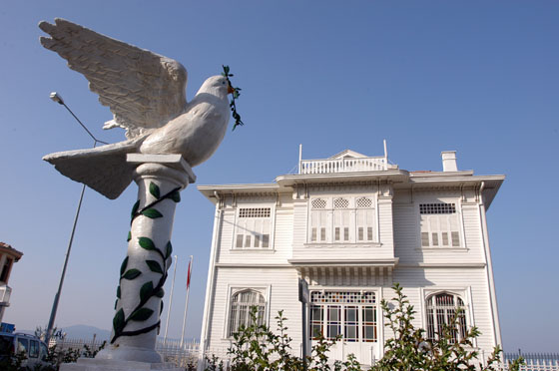
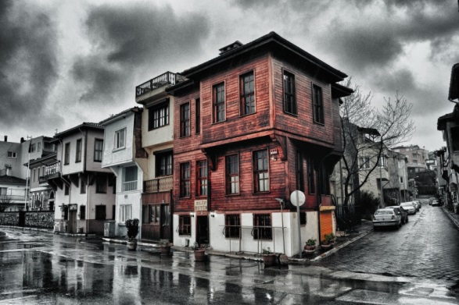
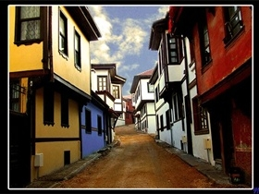
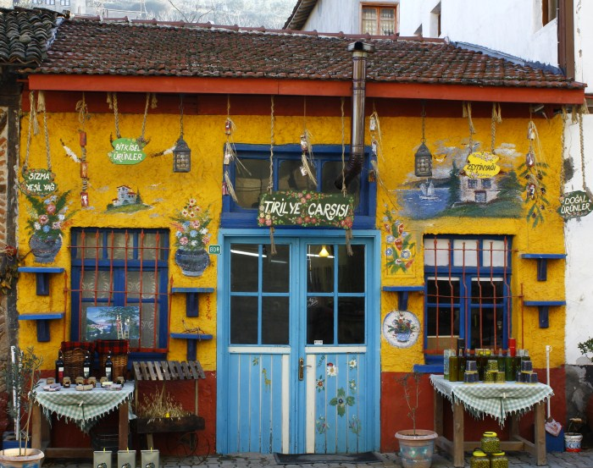
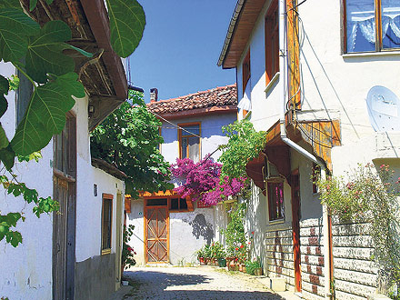

Slide 15
